Slide 1

Sri venketasawara college of engineering & technology
Department of computer science and engineering
Welcome to internship presentation
Heartful thanks to respected Principal sir Dr.M.Mohhan.Babu &
Head of Department Dr. P. J yoteswari Madam
special thanks to our class incharge Mr.Thirumurgan Sir.

Slide 2
My internship project
House price prediction :
By Pramanand Kumar Kurmi
Deen Bandhu Kurmi
Jai JDU
B.Tech 4th year

Slide 3

IIDT(International institute of digital technologies)
It provides online program in the comfort & safety of your home
It runs various online course like:
Web development
Machine learning
Android app deveploment
Cyber security
Python
Automobiles
Internet of Things
Robotics and Socialmedia for enterprises etc.

Slide 4

advanced MACHINE LEARNING

Slide 5
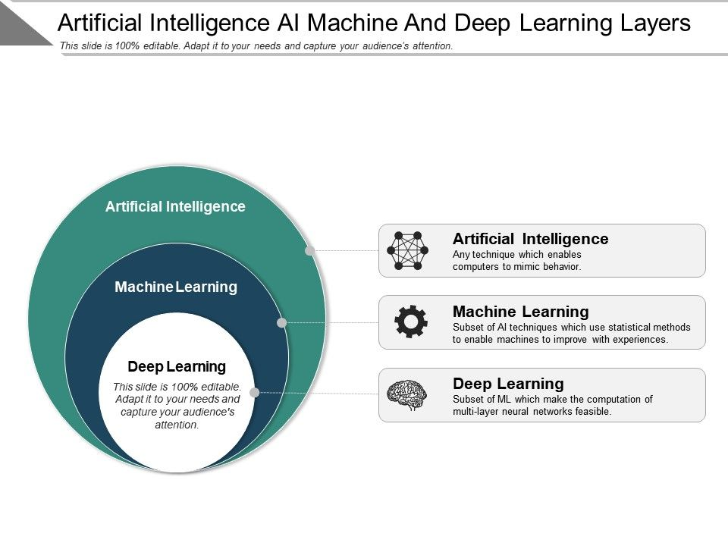
: Ml is a part of ai

Slide 6
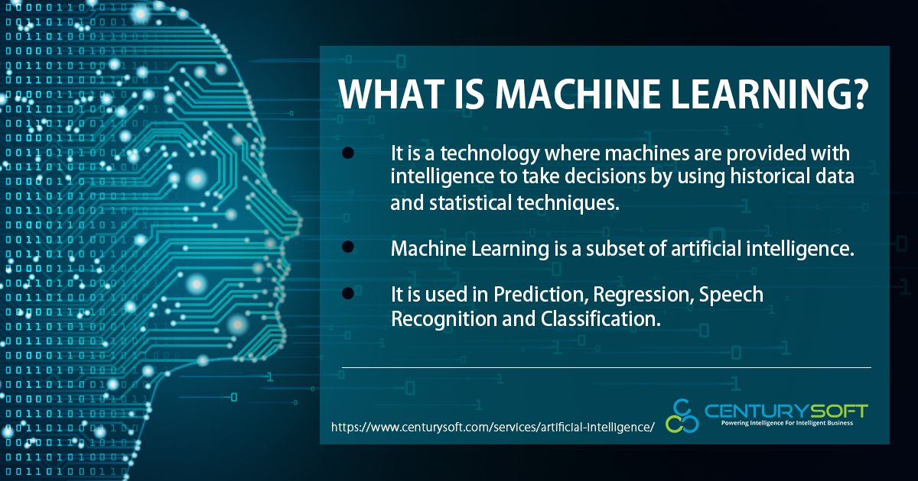
: About ml

Slide 7
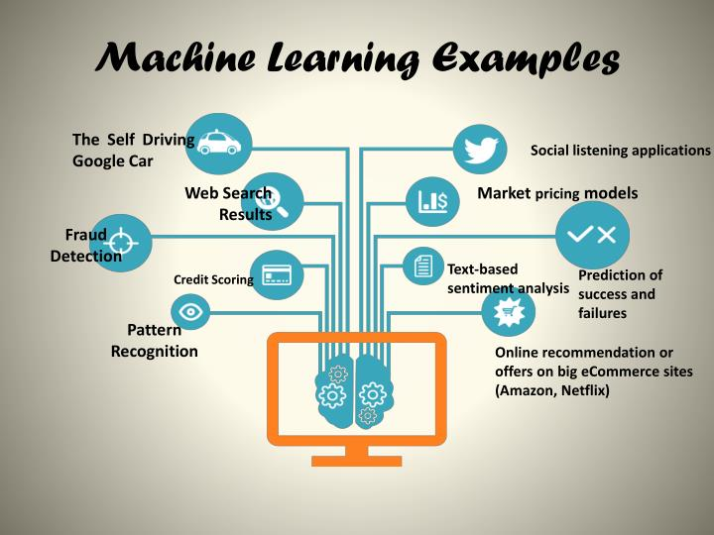
Using ml in our daily life cycle:

Slide 8
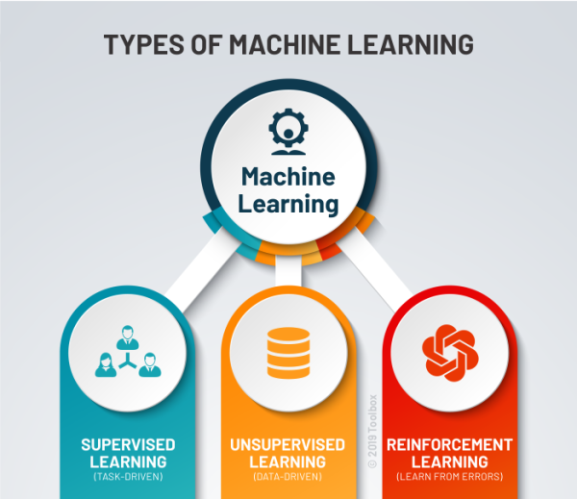
Types of machine learning
Mainly there are three types:
Supervised Learning
Unsupervised Learning
Reinforcement Learning

Slide 9
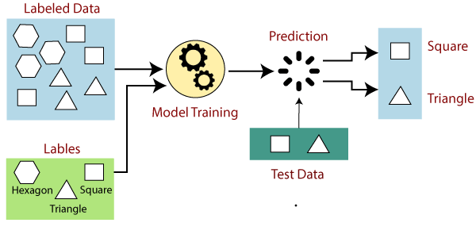
Supervised Learning :
its use of labeled datasets.
classify data or predict outcomes accurately

Slide 10
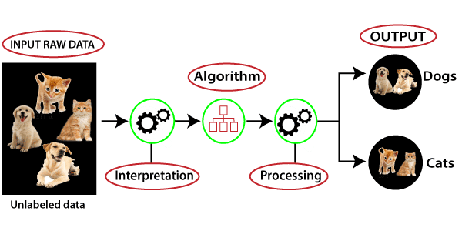
UNSupervised Learning :
technique in which models are not supervised using training dataset.
Unsupervised learning cannot be directly applied to a regression or classification problem

Slide 11
REINFORCEMENT Learning :
It is a feedback-based Machine learning technique
the agent learns automatically using feedbacks without any labeled data, unlike supervised learning.
It is a type of machine learning method where an intelligent agent (computer program) interacts with the environment and learns to act within that."

Slide 12

My project(house price prediction)
We all have experienced a time when we have to look up for a new house to buy.
But then the journey begins with a lot of frauds, negotiating deals, researching the local areas and so on.
It can help the developer determine
the selling price of a house.
It can help the customer to arrange
the right time to purchase house.

Slide 13
Real life example:
There comes a point in everyone’s life when the person wishes to buy or sell a house.
First consider a scenario where a person needs to buy a house.
The person will look for his/her desired house for a sensible price tag.
The person will have some features decided what he/she wants to have in the house.
The person will be able to decide whether the type of house he/she is looking for is worth of the price or not.

Slide 14
So to deal with this kind of issues Today we will be preparing a MACHINE LEARNING Based model :
There are the dataset contains 7 features:
1.Average Area Of Income
2.Average Area House Age
3.Average Area Number Of Rooms
4.Average Area Number Of Bedrooms
5.Area Population
6.Price
7.Addresss

Slide 15
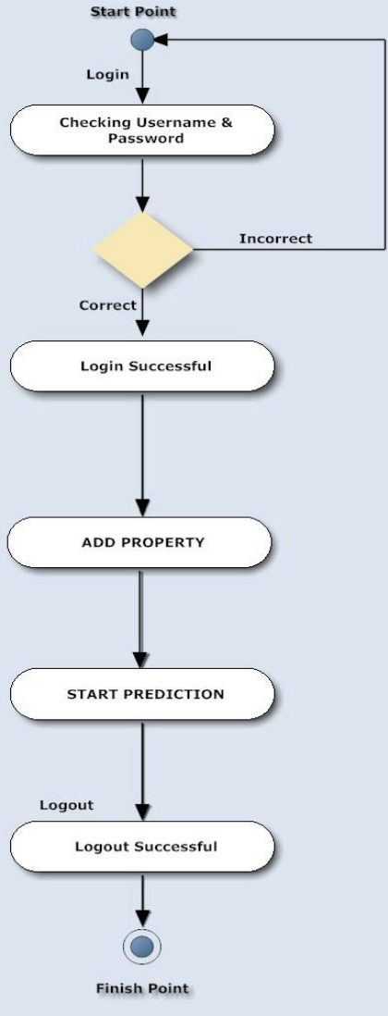
Data flow diagram of house price prediction:
User activity:-
User can Search property, add property for selling.
They can also look for rent by search method after logging in.
Results are fetched and added from the main database.

Slide 16
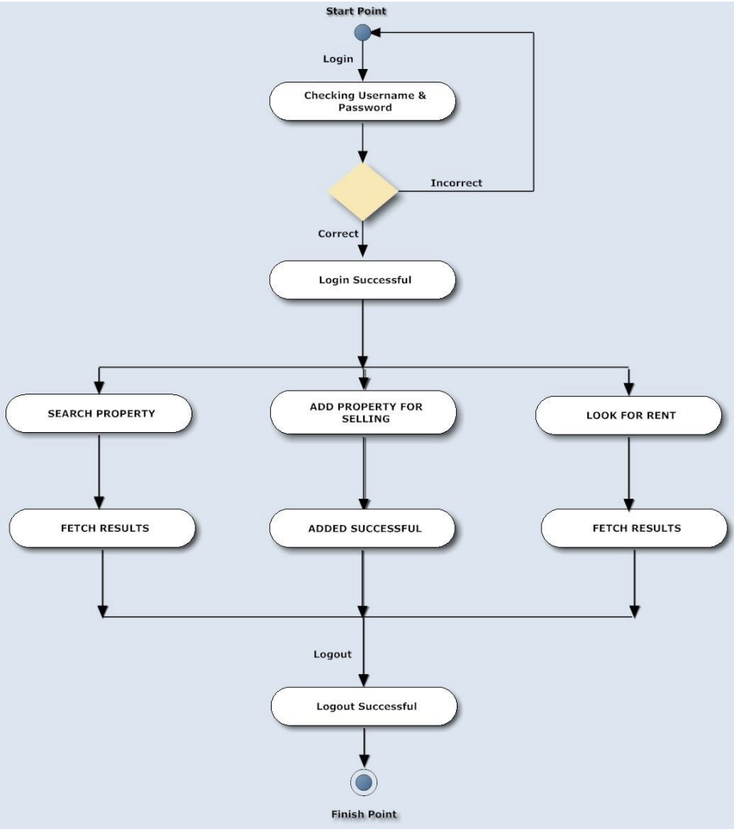
The output :
Prediction house prices are expected to help people.
They plan to buy a house so they can know the price range in the future.
They can plan their finance well.
In addition, house price predictions are also beneficial for property investors to know the trend of housing prices in a certain location.

Slide 17
Why house price prediction is important & helpful for future :
House Price prediction, is important to drive Real Estate efficiency.
As earlier, House prices were determined by calculating the acquiring and selling price in a locality.
Therefore, the House Price prediction model is very essential in filling the information gap
It improve Real Estate efficiency.
With this model, we would be able to better predict the prices.

Slide 18
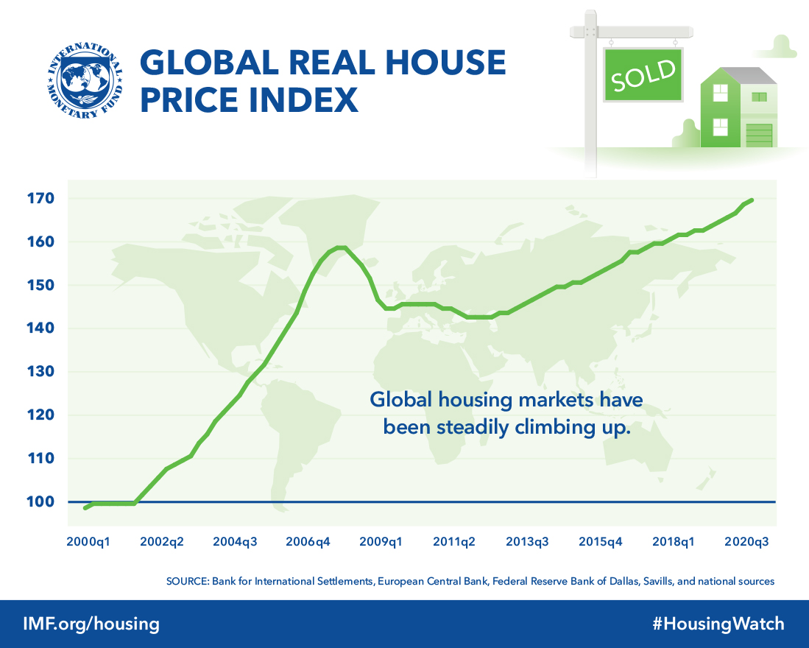
Global price graph :

Slide 19
Conclusion :
This model can make 91% accurate prediction for a house price Features that go through the model are;
Location (latitude and longitude)
Number of bedrooms Living lot and basement size
Number of views the house get Year of built Number of floors Condition.

Slide 20
References :
www.kaggle.com
https://www.geeksforgeeks.org/
https://www.javatpoint.com/
https://m.youtube.com/
https://image.githubusercontent.com/
https://Miro.medium.com/
https://www.upgrad.com/
https://www.ijert.org/

Slide 21


